Slide 1





Chapter 4: Processes
Process Concept
Process Scheduling
Operations on Processes
Cooperating Processes
Interprocess Communication
Communication in Client-Server Systems
Operating System Concepts
4.1
Silberschatz, Galvin and Gagne
2002

Slide 2
Process Concept
An operating system executes a variety of programs:
✦ Batch system – jobs
✦ Time-shared systems – user programs or tasks
Textbook uses the terms job and process almost
interchangeably.
Process – a program in execution; process execution
must progress in sequential fashion.
A process includes:
✦ program counter
✦ stack
✦ data section
Operating System Concepts
4.2
Silberschatz, Galvin and Gagne
2002

Slide 3
Process State
As a process executes, it changes state
✦ new: The process is being created.
✦ running: Instructions are being executed.
✦ waiting: The process is waiting for some event to occur.
✦ ready: The process is waiting to be assigned to a process.
✦ terminated: The process has finished execution.
Operating System Concepts
4.3
Silberschatz, Galvin and Gagne
2002

Slide 4
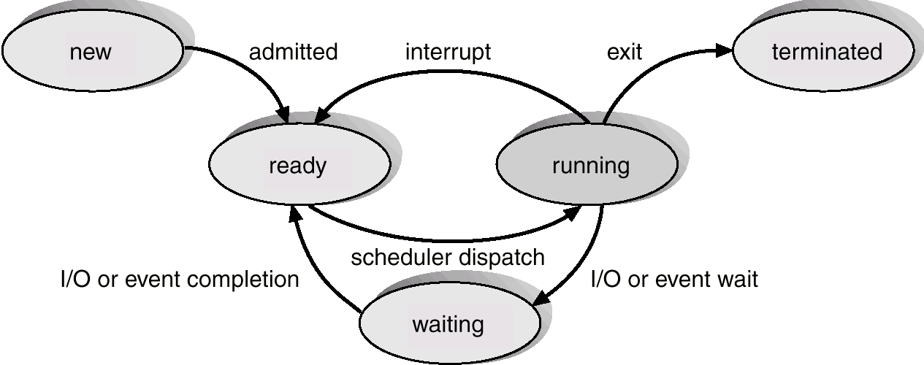
Diagram of Process State
Operating System Concepts
4.4
Silberschatz, Galvin and Gagne
2002

Slide 5
Process Control Block (PCB)
Information associated with each process.
Process state
Program counter
CPU registers
CPU scheduling information
Memory-management information
Accounting information
I/O status information
Operating System Concepts
4.5
Silberschatz, Galvin and Gagne
2002

Slide 6
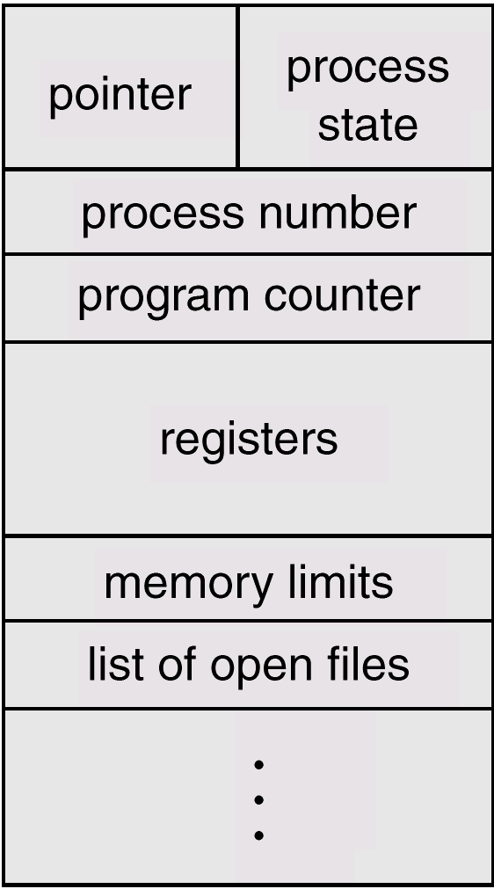
Process Control Block (PCB)
Operating System Concepts
4.6
Silberschatz, Galvin and Gagne
2002

Slide 7
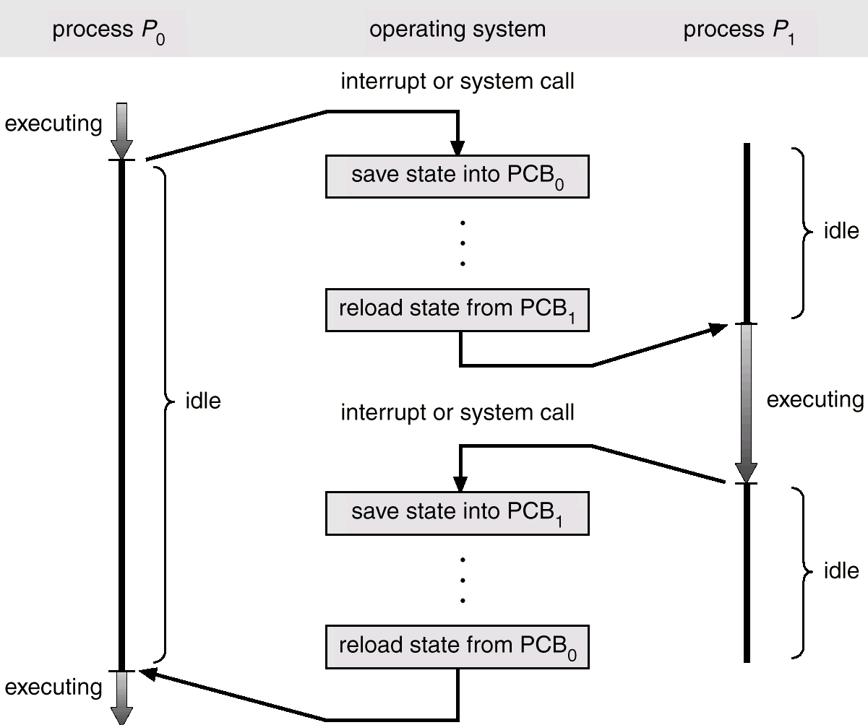
CPU Switch From Process to Process
Operating System Concepts
4.7
Silberschatz, Galvin and Gagne
2002

Slide 8
Process Scheduling Queues
Job queue – set of all processes in the system.
Ready queue – set of all processes residing in main
memory, ready and waiting to execute.
Device queues – set of processes waiting for an I/O
device.
Process migration between the various queues.
Operating System Concepts
4.8
Silberschatz, Galvin and Gagne
2002

Slide 9
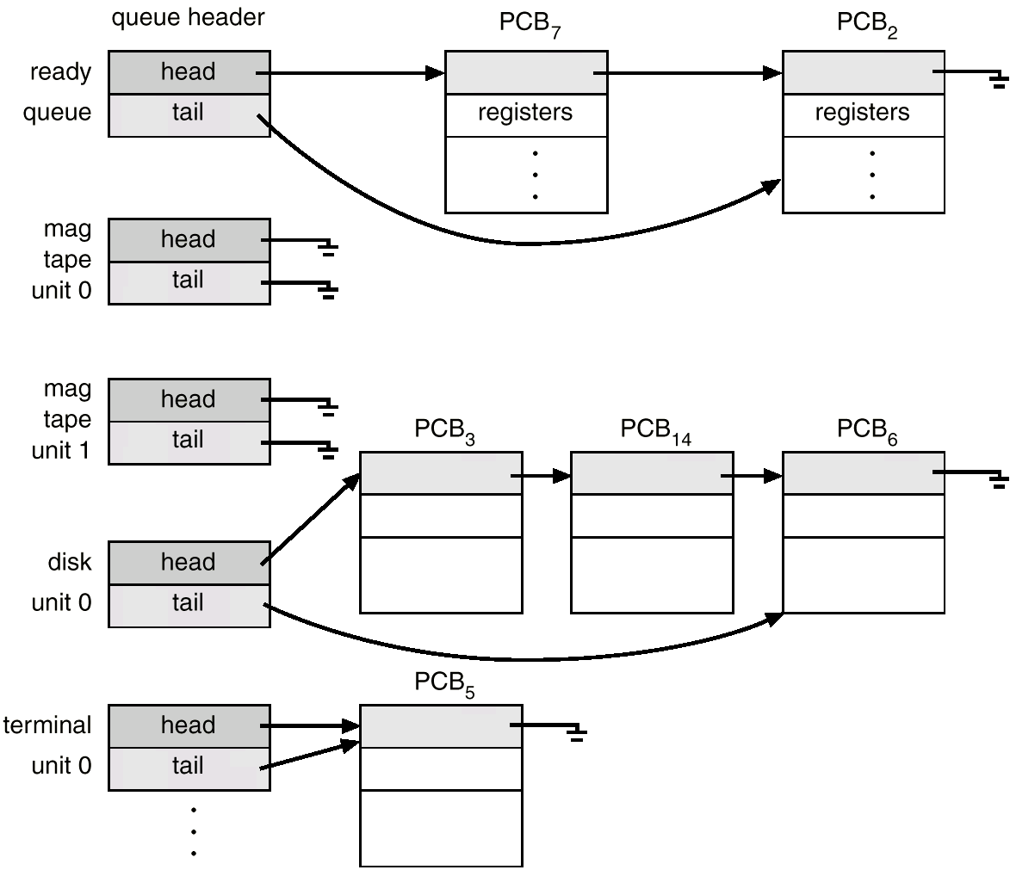
Ready Queue And Various I/O Device Queues
Operating System Concepts
4.9
Silberschatz, Galvin and Gagne
2002

Slide 10
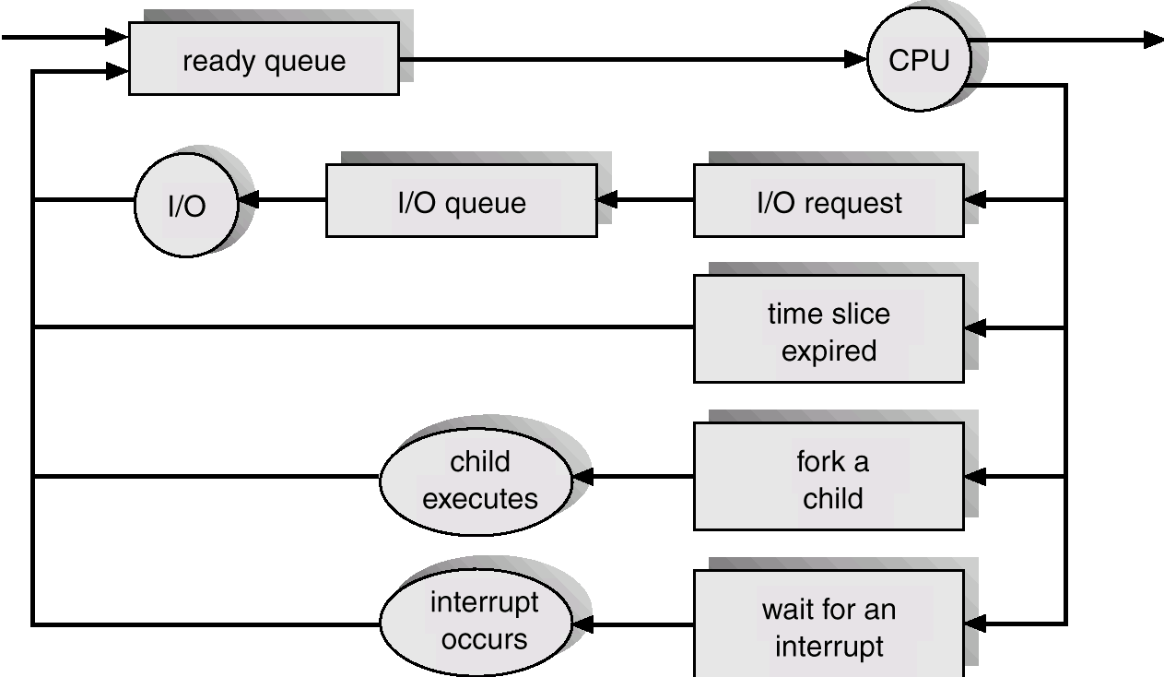
Representation of Process Scheduling
Operating System Concepts
4.10
Silberschatz, Galvin and Gagne
2002

Slide 11
Schedulers
Long-term scheduler (or job scheduler) – selects which
processes should be brought into the ready queue.
Short-term scheduler (or CPU scheduler) – selects which
process should be executed next and allocates CPU.
Operating System Concepts
4.11
Silberschatz, Galvin and Gagne
2002

Slide 12
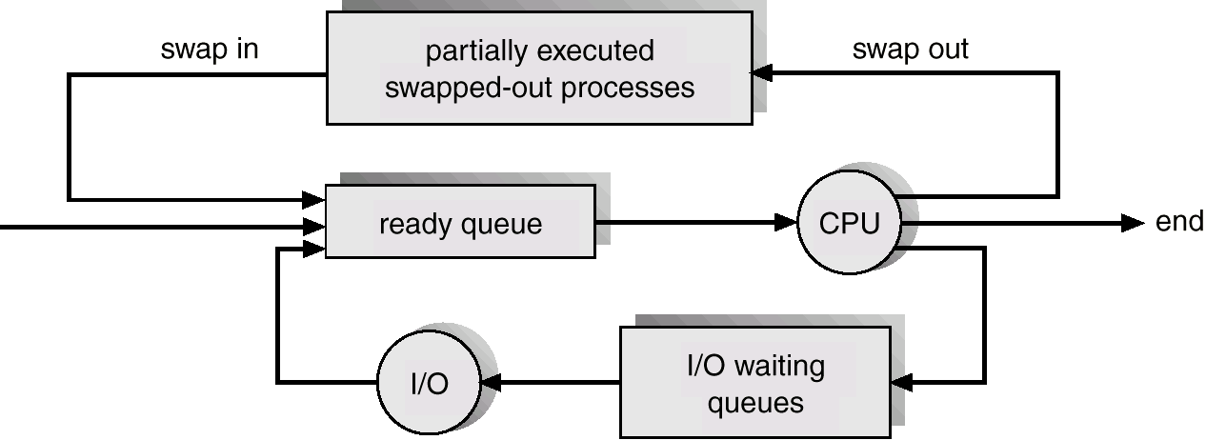
Addition of Medium Term Scheduling
Operating System Concepts
4.12
Silberschatz, Galvin and Gagne
2002

Slide 13
Schedulers (Cont.)
Short-term scheduler is invoked very frequently
(milliseconds) (must be fast).
Long-term scheduler is invoked very infrequently
(seconds, minutes) (may be slow).
The long-term scheduler controls the degree of
multiprogramming.
Processes can be described as either:
✦ I/O-bound process – spends more time doing I/O than
computations, many short CPU bursts.
✦ CPU-bound process – spends more time doing
computations; few very long CPU bursts.
Operating System Concepts
4.13
Silberschatz, Galvin and Gagne
2002

Slide 14
Context Switch
When CPU switches to another process, the system must
save the state of the old process and load the saved state
for the new process.
Context-switch time is overhead; the system does no
useful work while switching.
Time dependent on hardware support.
Operating System Concepts
4.14
Silberschatz, Galvin and Gagne
2002

Slide 15
Process Creation
Parent process create children processes, which, in turn
create other processes, forming a tree of processes.
Resource sharing
✦ Parent and children share all resources.
✦ Children share subset of parent’s resources.
✦ Parent and child share no resources.
Execution
✦ Parent and children execute concurrently.
✦ Parent waits until children terminate.
Operating System Concepts
4.15
Silberschatz, Galvin and Gagne
2002

Slide 16
Process Creation (Cont.)
Address space
✦ Child duplicate of parent.
✦ Child has a program loaded into it.
UNIX examples
✦ fork system call creates new process
✦ exec system call used after a fork to replace the process’
memory space with a new program.
Operating System Concepts
4.16
Silberschatz, Galvin and Gagne
2002

Slide 17
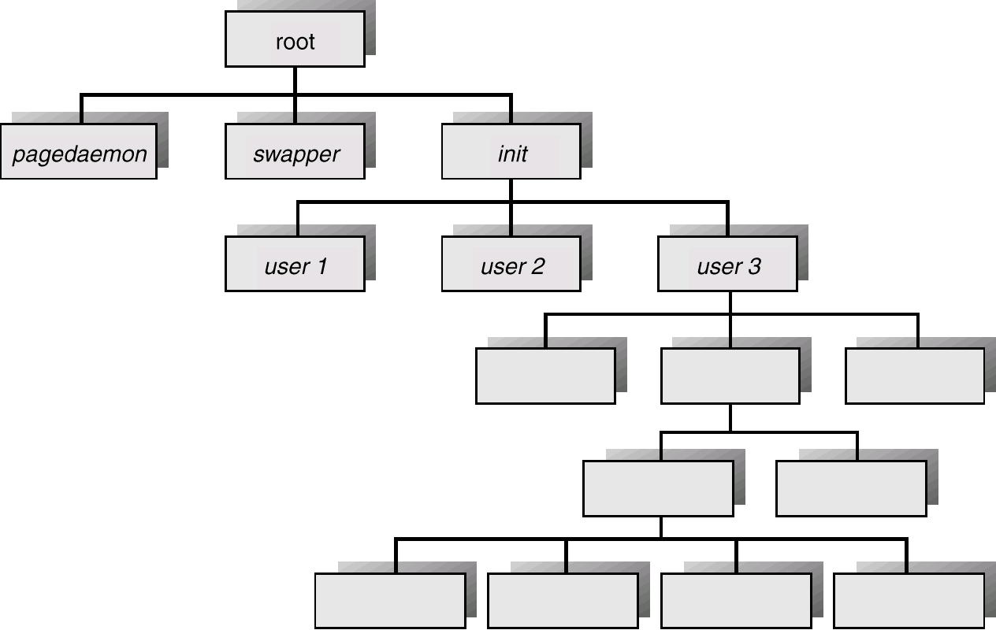
Processes Tree on a UNIX System
Operating System Concepts
4.17
Silberschatz, Galvin and Gagne
2002

Slide 18
Process Termination
Process executes last statement and asks the operating
system to decide it (exit).
✦ Output data from child to parent (via wait).
✦ Process’ resources are deallocated by operating system.
Parent may terminate execution of children processes
(abort).
✦ Child has exceeded allocated resources.
✦ Task assigned to child is no longer required.
✦ Parent is exiting.
✔Operating system does not allow child to continue if its
parent terminates.
✔Cascading termination.
Operating System Concepts
4.18
Silberschatz, Galvin and Gagne
2002

Slide 19
